Slide 1

Macroeconomic
Issues and Analysis:
an Overview

Slide 2
UNEMPLOYMENT
Nature of Unemployment
One of the major consequences of fluctuating business activity is the ensuing unemployment
Unemployment has many costs (i.e. human suffering, loss of dignity, loss of output and savings, rise in crime and social vices etc.)
Unemployment is considered to be a social evil that must be kept at an “acceptable” level

Slide 3
The nature of unemployment
The meaning of ‘unemployment’
  It is the number of people who are actively looking for work but are currently without a job.
  Persons who are employed for pay are defined as employed
  Persons who are not employed for pay but are unable to work and actively seeking work or awaiting recall from layoffs are defined as unemployed
  Persons who are not employed for pay because of inability to work or are not actively seeking work are NOT counted as part of the Labor force (.i.e. disables, house wives, students etc.)
  Labour force (L) is the number employed (E) plus the number unemployed (U) (i.e. In Ghana, it includes adults from 18 to 60 yrs): L = E + U
Notes:
8

Slide 4

Measuring Unemployment
unemployment rate is the number unemployed expressed as a percentage of the labour force.
  Thus, if 25 million people were employed and 1.5 million people were unemployed, the unemployment rate would be:

Slide 5
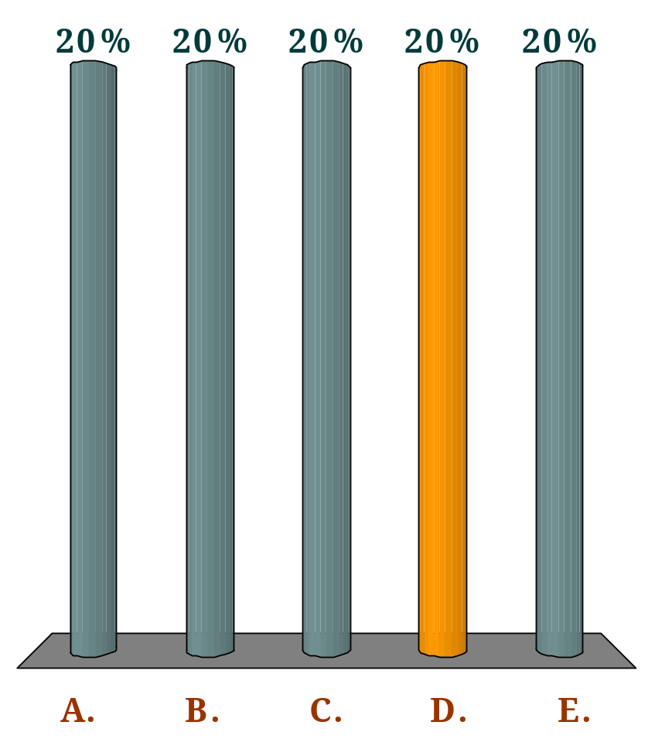
If there are 3 million people unemployed and 24 million people employed, the rate of unemployment will be:
Q
3 per cent
8 per cent
9 per cent
11.1 per cent
12.5 per cent

Slide 6
Flows into and out of unemployment
From jobs
From outside the labour force
People made redundant
People sacked
People temporarily laid off
People resigning
School/college leavers
People returning to the
labour force (e.g. after
raising children)
INFLOWS
(per period of time)
UNEMPLOYMENT
To jobs
OUTFLOWS
(per period of time)
To outside the
labour force
People taking new jobs
People returning to old
jobs who had been
temporarily laid off
People who have become disheartened
and give up looking for a job
People who have reached retirement age
People who temporarily withdraw from
labour force (e.g. to raise a family)
People who emigrate
People who die

Slide 7
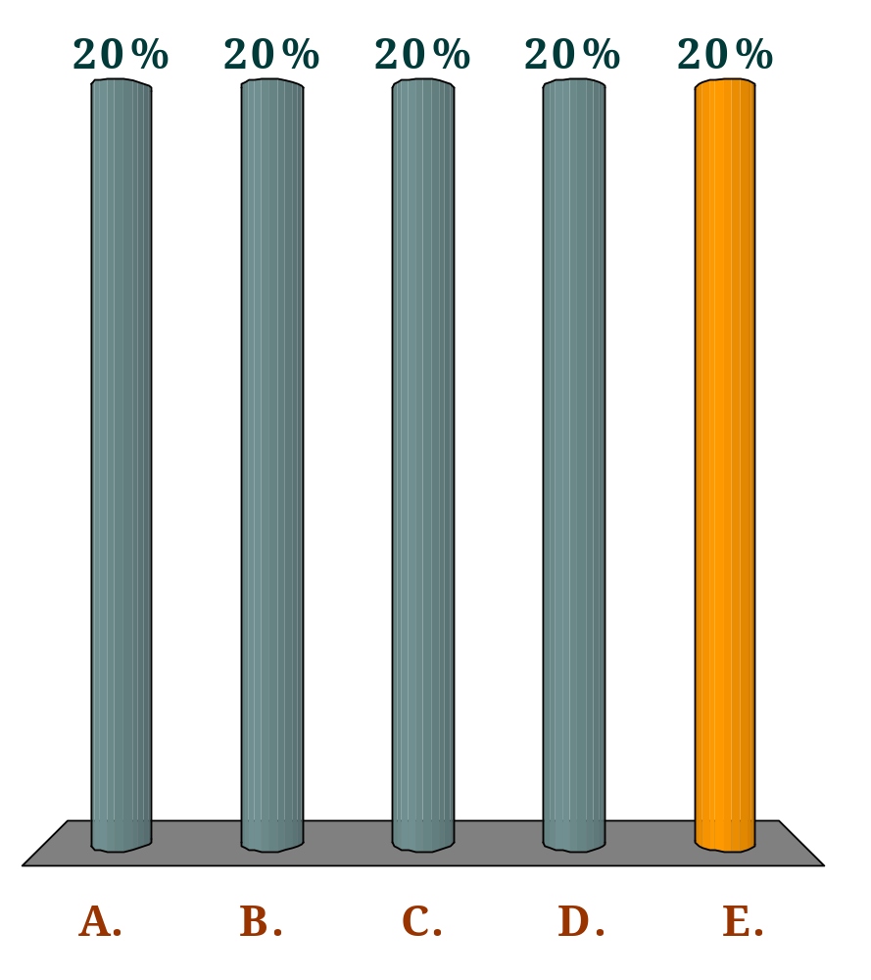
Which one of the following will increase the level of unemployment?
Q
More people retire.
More unemployed people become disheartened and give up looking for work.
The school leaving age is raised.
The retirement age is lowered.
More people resign from low-paid jobs.

Slide 8
The costs of unemployment
Unemployment has social, economic and human costs
  to the unemployed themselves (i.e. Poverty, mental disorders, illness, loss of dignity & self-esteem etc.)
  to family and friends (i.e. Strained personal relations, increase in domestic violence and broken homes)
  to society at large (i.e. Loss of gov’t tax revenue, decline in national output (income), increase in crimes, increase in gov’t expend. to combat crime and pay unemployment benefits)
Notes:
9

Slide 9
Causes of unemployment
Unemployment and the labour market
  the labour market is where labour as a factor of production is demanded (bought) and supplied (sold).
Aggregate demand of labour is the total demand for labour in the economy.
  A curve showing the total demand for labour in the economy at different average real wage rates is called the aggregate demand for labour curve
Aggregate supply of labour is the total supply of labour in the economy
  A curve showing the total number of people willing and able to work at different average real wage rates is called the aggregate supply of labour curve.
Notes:
10

Slide 10
Equilibrium in the Labor Market
AS_{L}
The labour market is in equilibrium at a wage of W –where the demand for labour equals the supply.
Average (real) wage rate
W_{e}
AD_{L}
O
Q_{e}
No. of workers

Slide 11
Disequilibrium unemployment
At a wage rate of W1, there is an excess supply of labour of A – B.
AS_{L}
Disequilibrium may be due to:
Excess supply of labour over demand
‘Stickiness’ in wages.
Disequilibrium
unemployment
Average (real) wage rate
B
A
W₁
W_{e}
AD_{L}
O
Q₂
Q₁
No. of workers

Slide 12
Disequilibrium and Equilibrium unemployment
Disequilibrium unemployment
  Is the unemployment resulting from real wage rates in the economy being above the equilibrium level.
Even when the labour market is in equilibrium, however, not everyone looking for work will be employed.
Some people will hold out, hoping to find a better job
Equilibrium (‘natural’) unemployment
  Is the difference between those who would like employment at the current wage rate and those willing and able to take a job.

Slide 13
Types of Disequilibrium Unemployment
There are three causes of disequilibrium unemployment
  real-wage (classical) unemployment
    Occurs when trade unions use their monopoly power to drive wages above the market-clearing level.
    It could also be caused by the government setting the national minimum wage too high.
Notes:
10

Slide 14
Types of Disequilibrium unemployment
  demand-deficient (cyclical) unemployment
    Is associated with economic recessions.
    Demand-deficiency means there is lack-of-effective demand in the economy such that aggregate demand falls short of aggregate supply
    As the economy moves into recession, consumer demand falls, unsold stocks pile up, firms cut back on production and lay off workers.
Notes:
10

Slide 15
Demand-deficient unemployment
AS_{L}
Sticky wages
Demand-deficient unemployment
Average (real) wage rate
W₁
Reduction in aggregate demand
W₂
AD_{L 1}
AD_{L 2}
O
Q₂
Q₁
No. of workers

Slide 16
demand-deficient (cyclical) unemployment......Cont’d
demand-deficient (cyclical) unemployment is therefore disequilibrium unemployment caused by a fall in aggregate demand with no corresponding fall in the real wage rate.
Demand-deficient unemployment is also referred to as ‘Keynesian unemployment’, after John Maynard Keynes
Because demand-deficient unemployment fluctuates with the business cycle, it is sometimes referred to as ‘cyclical unemployment’.
Notes:
10

Slide 17
Causes of Disequilibrium unemployment.......Cont’d.
unemployment arising from a growth in the labour supply
  If labour supply rises with no corresponding increase in the demand for labour, the equilibrium real wage rate will fall.
  If the real wage rate is ‘sticky’ downwards, disequilibrium unemployment will occur.

Slide 18
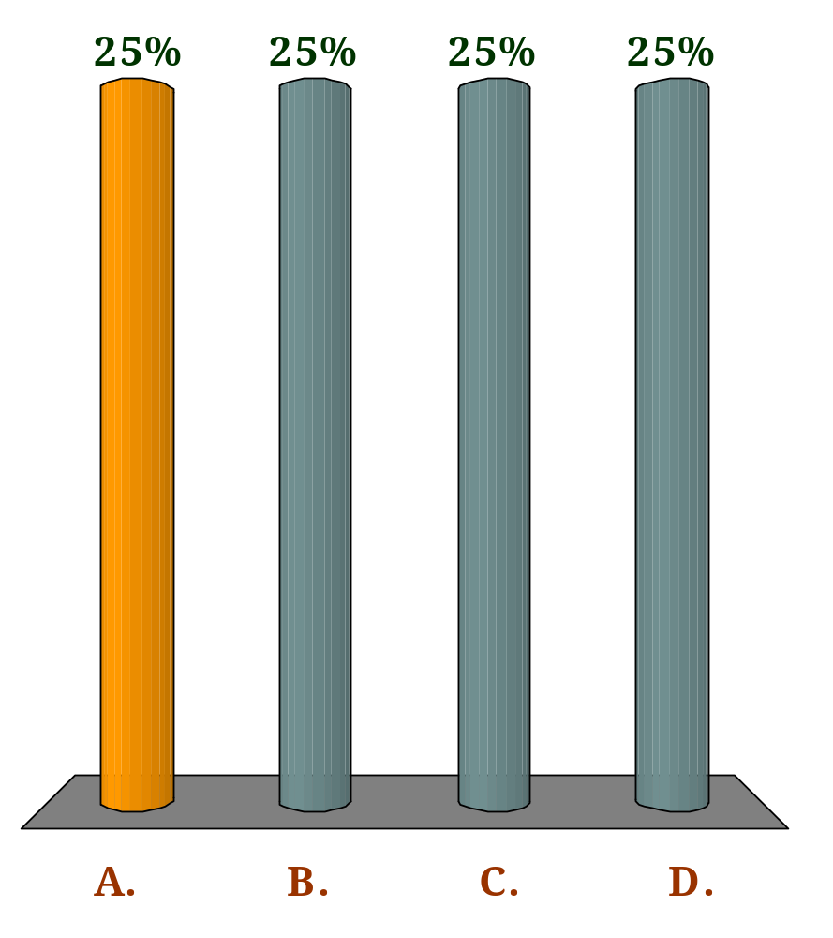
Which of the following defines real-wage unemployment?
Q
Real wages being set above the equilibrium level by trade unions, or minimum wage legislation.
Inflation causing an erosion of real wages and hence a rise in unemployment.
Increased aggregate demand in the economy driving up equilibrium real wages.
Increased aggregate demand in the economy causing money wages to rise faster than real wages.

Slide 19
Types Equilibrium of unemployment
Although there may be overall macroeconomic equilibrium, with the aggregate demand for labour equal to the aggregate supply, at a microeconomic level supply and demand may not match.
There may be excess demand for labour (vacancies) in some markets and excess supply (unemployment) in others
This will result in equilibrium unemployment
Notes:
12

Slide 20
Types Equilibrium of unemployment
frictional (search) unemployment
  occurs when people leave their jobs, either voluntarily or because they are sacked or made redundant, and are unemployed for a period of time while they are looking for a new job.
  It is unemployment that occurs as a result of imperfect information in the labour market. It often takes time for workers to find jobs (even though there are vacancies) and in the meantime they are unemployed.

Slide 21
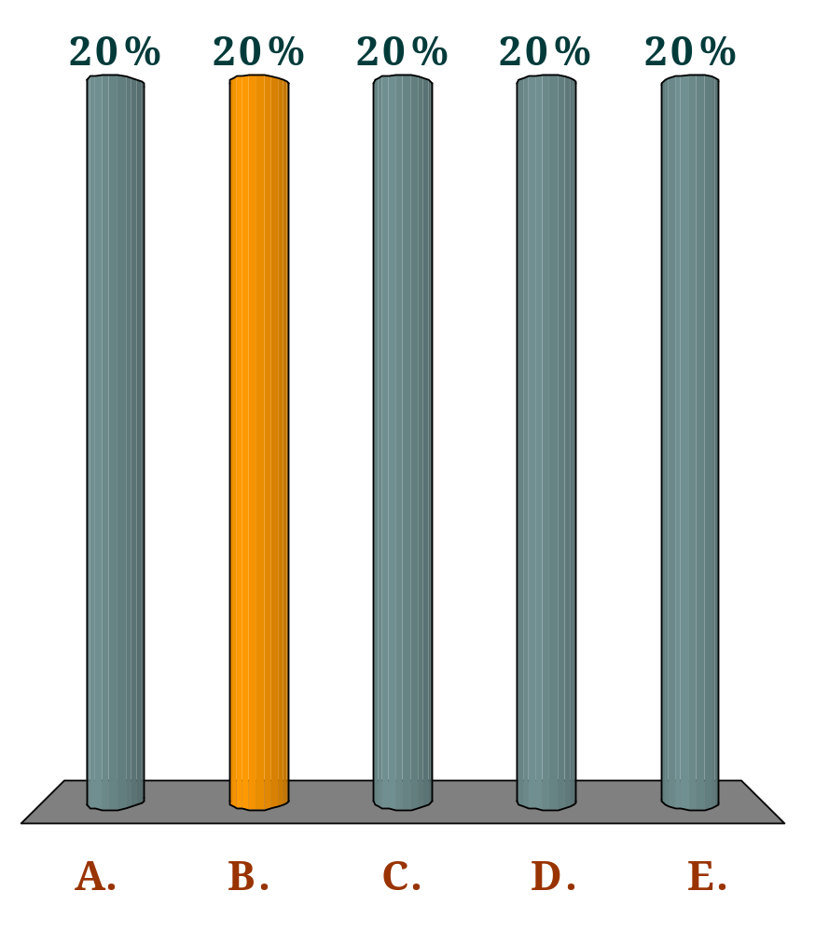
Frictional unemployment is the result of:
Q
a shift in the pattern of consumer demand.
workers and employers being ill-informed about the labour market.
the introduction of new technology.
the economy entering the recessionary phase of the business cycle.
employers responding to the time of year and cutting back on their level of production.

Slide 22
Types Equilibrium of unemployment
structural unemployment
  it occurs where the structure of the economy changes. Employment in some industries may expand while in others it contracts
  Two main reason for this:
    changing pattern of demand resulting from a change in consumer tastes, fashion etc.
    technological unemployment due to a change in the method of production (i.e. Labor-saving technical progress)
  regional unemployment is a type of structural unemployment occurring in specific regions of the country where particular industries are concentrated.
Notes:
12

Slide 23
Types of Equilibrium Unemployment (Con’t)
  The level of structural unemployment depends on 3 factors
    The degree of regional concentration of industry
    The speed of change of demand and supply in the economy
    The immobility of labour
  seasonal unemployment
    Occurs when the demand for certain types of labour fluctuates with the seasons of the year.
  Unemployment associated with industries or regions where the demand for labour is lower at certain times of the year.

Slide 24
Policies to tackle unemployment
A market-orientated approach involves encouraging people to look more actively for jobs, if necessary in other parts of the country.
  It involves encouraging people to adopt a more willing attitude towards retraining, and if necessary to accept some reduction in wages.
An interventionist approach involves direct government action to match jobs to the unemployed.
  Two examples are providing grants to firms to set up in areas of high unemployment (regional policy), and government-funded training schemes.
Notes:
12

Slide 25
AD, AS and the price level
Before we examine the causes of inflation (the rate of increase in prices), we need to look at how the level of prices in the economy is determined.
It is determined by the interaction of aggregate demand and aggregate supply
The analysis is similar to that of demand and supply in individual markets, although there are some crucial differences.

Slide 26
The Aggregate Demand (AD) Curve
Remember we said AD is the total level of spending in the economy and is obtained as
  AD = C + I + G + (X-M)
The aggregate demand curve shows how much national output (GDP) will be demanded at each level of prices.

Slide 27
Aggregate demand and aggregate supply
  Why the AD curve slopes downwards
    foreign trade effect
    real balance effect
    interest rate effect
  The shape of the AD curve
  Shifts in the AD curve
Price level
AD
O
National output

Slide 28
Why does the AD curve slope downwards
The aggregate demand curve is negatively sloped showing that less is demanded at higher prices because of:
income effect
  higher prices reduce the real income of consumers, making people to spend less, and thus, causing AD to fall
substitution effects or foreign trade effect
  Higher prices for our country’s goods will discourage foreign residents from buying our exports and encourage domestic residents to buy imports
  Thus higher domestic prices will lead to a fall in aggregate demand
Interest rate effect
  Higher prices increase the demand for money as households and firms would need more money to purchase the same amount of output
  Higher demand for money creates shortage of money causing banks to raise the interest rate on loans granted
  Higher interest rates makes borrowing expensive and thus lowers interest-sensitive expenditure and AD.

Slide 29
Shifts in the AD Curve
The aggregate demand curve can shift inwards (to the right) or outwards (to the left)
  A rightward shift represents an increase in aggregate demand, whatever the price level; a leftward shift represents a decrease in aggregate demand, whatever the price level.
A shift in the aggregate demand curve will occur if, for any given price level, there is a change in any of its components – C, I, G or X minus M
  Thus if the government decides to spend more, or if consumers spend more as a result of lower taxes, or if business confidence increases so that firms decide to invest more, the AD curve will shift to the right.

Slide 30
The Aggregate Supply (AS) curve
The Aggregate Supply (AS) curve shows the amount of goods and services that firms are willing to supply at each level of prices
When constructing this curve, we assume that various other things remain constant.
  These include: wage rates and other input prices, technology and the total supply of factors of production
The short-run aggregate supply curve slopes upwards
  In other words, the higher the level of prices, the more will be produced
The reason is simple
  All other things being equal, as the prices of their products rise, firms’ profitability at each level of output will be higher than before.
  This will encourage them to produce more.

Slide 31
Aggregate demand and aggregate supply
AS
Price level
O
National output

Slide 32
Shift in the AS curve
The aggregate supply curve will shift if there is a change in any of the variables that are held constant when we plot the curve.
Examples of these variables are
  technology,
  the labour force
  the stock of capital
  wage rates
  taxes and subsidies etc.,

Slide 33
Equilibrium
Equilibrium in the macroeconomy occurs when:
  aggregate demand and aggregate supply are equal

Slide 34
Aggregate demand and aggregate supply
AS
Price level
If the price level is initially P₂, the excess demand will cause price level to rise to P_{e}
P_{e}
b
a
P₂
AD
O
National output

Slide 35
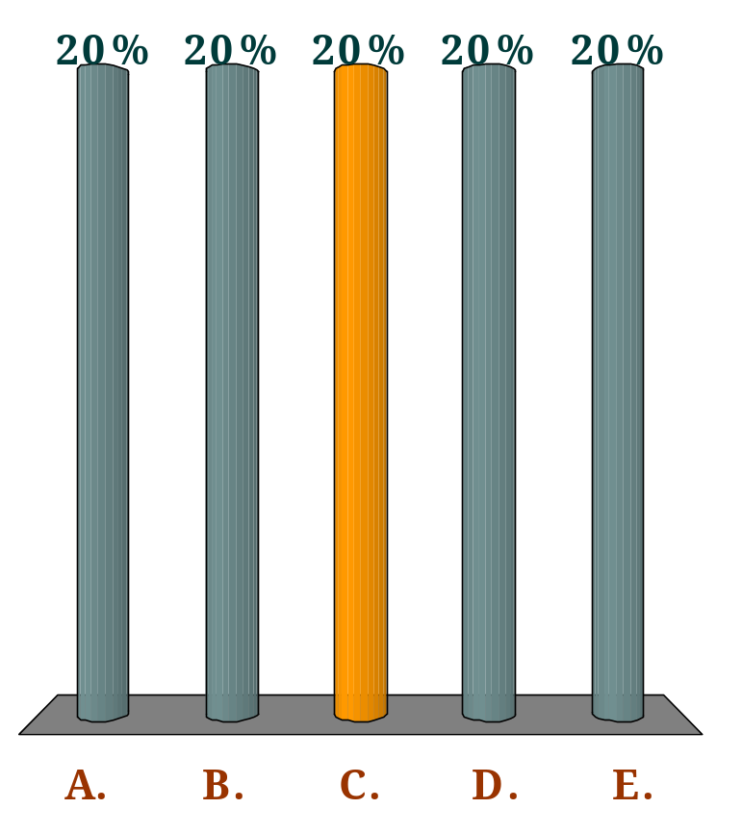
As the price level in the economy rises, which of the following occur(s)?
(i) The quantity of ‘real money’ decreases;
(ii) Real aggregate demand decreases;
(iii) Total spending in money terms decreases.
Q
(i) only
(ii) only
(i) and (ii)
(i) and (iii)
(i), (ii) and (iii)

Slide 36
Shifts in the AD or AS curves
If the AD or AS curve shifts, there will be a movement along the other curve to the new point of equilibrium
A rise in the price level will occur if there is a rightward shift in the aggregate demand curve or a leftward shift in the aggregate supply curve.

Slide 37
Inflation
Defining inflation
  Is a situation in which there is a sustained or persistent rise in the general price level
  The rate of inflation measures the annual percentage increase in prices.
  The most usual measure of inflation is that of consumer prices: i.e. retail prices.
Notes:
13

Slide 38


Measuring Inflation
The Ghanaian government publishes a consumer prices index (CPI) each month
the rate of inflation is the percentage increase in that index over the previous 12 months
The inflation rate ( ) is calculated from the following formula:
Where is the price index for year t and is the price index for the previous year. Thus if the price index for year 1 is 140.0 and for year 2 is 149.1, then inflation in year 2 is:

Slide 39
Suppose that the CPI in a country increases from 150 to 153 over a period of a year. What is the rate of inflation?
Q
3%
2%
1.02%
0.03%
0.02%

Slide 40
‘hyperinflation’
This is when inflation gets out of hand with prices rising perhaps by several hundred per cent or even thousands per cent per year
This is also called ‘run away’ or ‘galloping inflation’
Some countries which have suffered from this type of inflation are Yugoslavia and recently Zimbabwe.

Slide 41
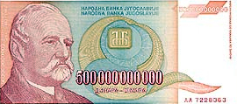
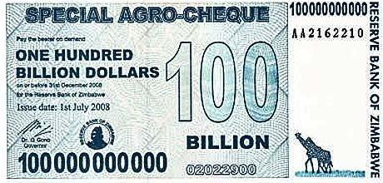
Yugoslavian banknote, 1994
Zimbabwe banknote, 2008

Slide 42
The costs of inflation
Why is inflation a problem?
  Redistribution
    Inflation redistributes income away from those on fixed incomes and those in a weak bargaining position, to those who can use their economic power to gain large pay, rent or profit increases.
    Pensioners may be particularly badly hit by rapid inflation.
  Uncertainty
    Inflation tends to cause uncertainty among the business community, especially when the rate of inflation fluctuates
    If it is difficult for firms to predict their costs and revenues, they may be discouraged from investing and this reduces the rate of economic growth
Notes:
13

Slide 43
Costs of inflation….Cont’d
  balance of payments
    Inflation is likely to worsen the balance of payments.
    If a country suffers from relatively high inflation, its exports will become less competitive in world markets. At the same time, imports will become relatively cheaper than home-produced goods.
    X will fall and M will rise
  Extra resources are used to cope with inflation
    Accountants and other financial experts may have to be employed by companies to help them cope with the uncertainties caused by inflation

Slide 44
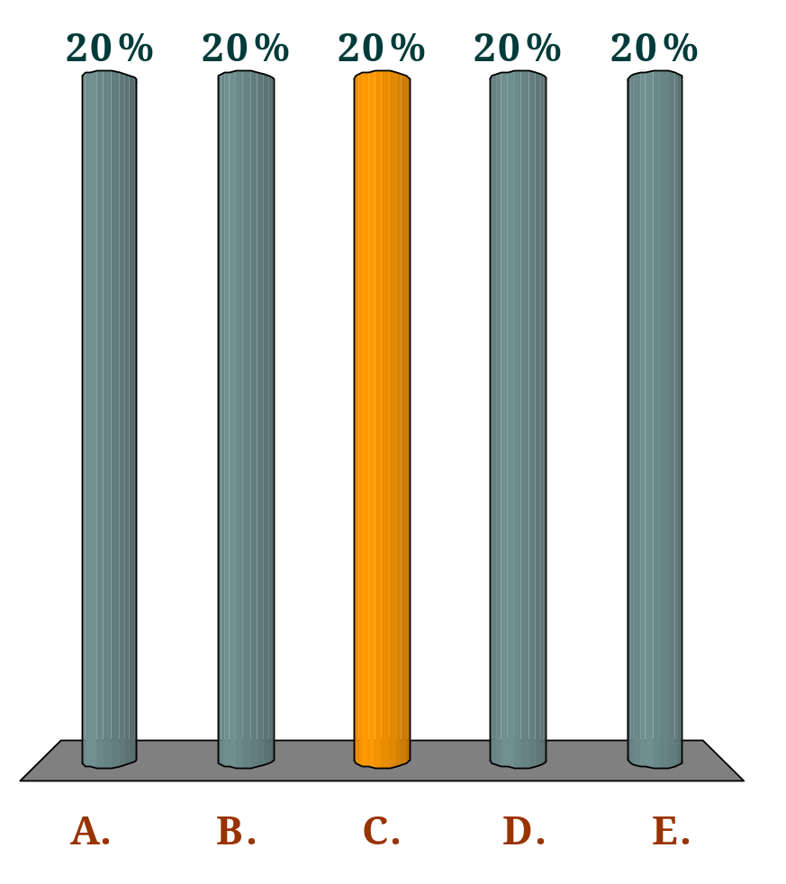
In a period of rapid inflation which of the following would be the least desirable store of wealth?
Q
Vintage wine.
Property
Money
Land
Stocks and shares

Slide 45
Types of inflation
Demand-pull inflation
  This is caused by continuing rises in aggregate demand and is associated with a booming economy
  Firms respond to a rise demand partly by raising prices and partly by increasing output
  The closer actual output gets to potential output, and the less ‘slack’ or ‘excess capacity’ there is in the economy, the more will firms respond to a rise in demand by raising their prices.
  A single increase in demand is called ‘demand shock’
  For inflation to persist, there must be continuing rightward shifts in AD
Notes:
14

Slide 46
Demand-pull inflation
z
AS
Here, it the Aggregate demand that ‘pulls’ up the price level
Price level
P₂
P₁
AD₂
AD₁
O
Q₁
Q₂
National output

Slide 47
Types of Inflation
Cost-push Push Inflation
  This is inflation caused by persistent rises in costs of production (independently of demand)
  This results in continuing leftward (upward) shift in AS curve
  If firms face a rise in costs, they will respond partly by raising prices and passing the costs on to the consumer, and partly by cutting back on production
  This leads to increases in the price level and fall in output (and employment)
Notes:
14

Slide 48
Cost-Push Inflation
Single shifts in the AS curve is known as a Supply Shock
  It may result from bad harvests
  This will only cause temporary inflation
Rises in costs (of production) may originate from
  Trade unions pushing up wages
  Firms with monopoly power raising prices in order to increase their profits
  Increases in international commodity prices (i.e . Input prices)

Slide 49
Cost-Push Inflation
Single shifts in the AS curve is known as a Supply Shock
  It may result from bad harvests
  This will only cause temporary inflation
Rises in costs (of production) may originate from
  Trade unions pushing up wages
  Firms with monopoly power raising prices in order to increase their profits
  Increases in international commodity prices (i.e . Input prices)

Slide 50
Cost-push inflation
AS₂
AS₁
Here, increasing costs of production pushes up the price level
Price level
P₂
P₁
AD
O
Q₂
Q₁
National output

Slide 51
Which one of the following would be the cause of cost-push inflation?
Q
A cut in the rate of income tax
A cut in the rate of VAT
A cut in interest rates
A rise in the exchange rate
A rise in the price of oil

Slide 52
Policies to tackle inflation
Demand-side policies
  Theses are policies designed to affect aggregate demand: fiscal policy and monetary policy.
  Fiscal policy involves affecting AD through altering the balance between government expenditure and taxation
  AD can be reduced by cutting gov’t expenditure or by raising taxes
  These are both examples of contractionary (or deflationary) fiscal policy
  Fiscal policy could also be used to boost aggregate demand by raising gov’t expenditure or by cutting or lowering taxes
  This is called expansionary (or reflationary) fiscal policy
  supply-side policies
Notes:
14

Slide 53
……Demand-side policies…..cont’d
Monetary Policies
  Monetary policy involves altering the supply of money in the economy or manipulating the rate of interest
  The government or central bank (the Bank of Ghana) can reduce aggregate demand (a contractionary monetary policy) by reducing the money supply
  This makes less money available for spending
  AD can also be reduced by putting up interest rates and thus making borrowing more expensive. If people borrow less, they will spend less.

Slide 54
Supply-side policies
The aim of supply-side policies is to reduce the rate of increase in costs so as to increase productivity (AS)
This can be done:
By restraining monopoly influences on prices and incomes (i.e. restricting the activities of trade unions , mergers and takeovers)
By designing policies to increase productivity (e. g. tax incentives, R&D, training of labour, giving grants to firms to invest in up-to-date equipment or machinery)

Slide 55

Which one of the following would be the cause of cost-push inflation?
Q
A cut in the rate of income tax
A cut in the rate of VAT
A cut in interest rates
A rise in the exchange rate
A rise in the price of oil

Slide 56
The balance of payments
Meaning of the balance of payments
  All countries are open economies.
  That is, all countries trade with and have financial dealings with the rest of the world.
  Balance of payments account is a record of the country’s transactions with the rest of the world.
  It shows the country’s payments to or deposits in other countries (debits) and its receipts or deposits from other countries (credits).
  It also shows the balance between these debits and credits under various headings.
Notes:
2

Slide 57
The 3 main parts of balance of payments Account
1. The current account
  The current account records payments for imports and exports of goods and services, plus incomes flowing into and out of the country, plus net transfers of money into and out of the country.
  The current account has 4 subdivisions, namely:
  trade in goods account (i.e. Records exports and imports of physical goods or visibles)
      The balance on this account is called balance on trade in goods or balance on of visible trade
      Surplus is when exports exceed imports
      A deficit is when imports exceed exports

Slide 58
.........subdivisions of the current a/c
trade in services account
  This records imports and exports of services (such as transport, tourism and insurance).
The balance of these is called the services balance.
The balance of both the goods and services accounts together is known as the balance on trade in goods and services or simply the balance of trade.
Notes:
2

Slide 59
.........subdivisions of the current a/c
  income flows
    These consist of wages, interest and profits flowing into and out of the country
  current transfers of money
    These include government contributions to and receipts from international organizations, and international transfers of money by private individuals and firms (like Western Union )
The current account balance is the overall balance of all the above four subdivisions.
Thus current account balance is the balance on trade in goods and services plus net investment incomes and current transfers
Notes:
2

Slide 60
Current Account Surplus and Deficit
A current account surplus is where receipts (credits) exceed payments (debits).
A current account deficit is where debits exceed credits

Slide 61
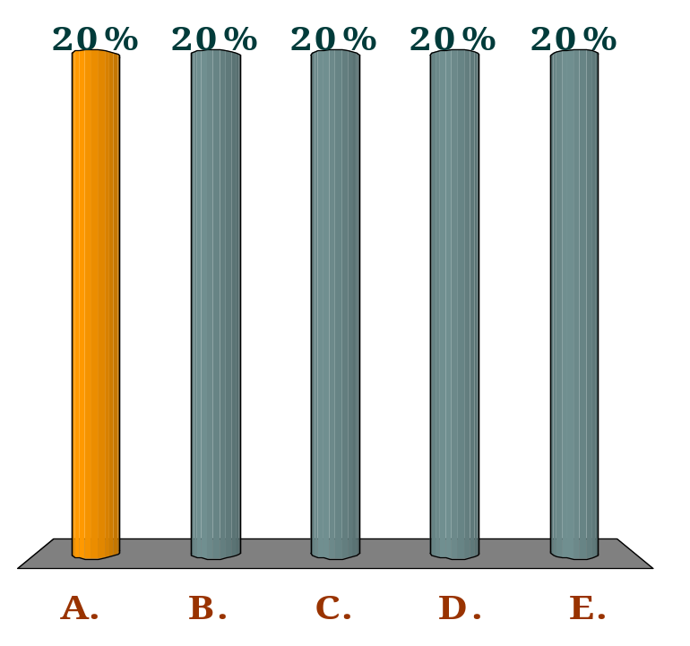
A country has the following items in its balance of payments:
Exports of goods £120m; Imports of services £60m
Income flows and current transfers from abroad £80m
Exports of services £50m; Imports of goods £150m
Income flows and current transfers going abroad £30m
Its balance of trade in goods and services is a:
Q
deficit of £40m.
deficit of £30m.
deficit of £20m.
deficit of £10m.
surplus of £10m.

Slide 62
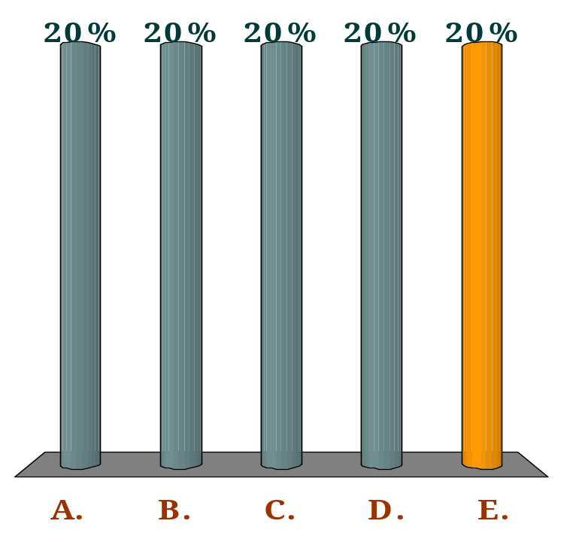
A country has the following items in its balance of payments:
Exports of goods £120m; Imports of services £60m
Income flows and current transfers from abroad £80m
Exports of services £50m; Imports of goods £150m
Income flows and current transfers going abroad £30m
Its current account balance is a:
Q
deficit of £40m.
deficit of £30m.
deficit of £20m.
deficit of £10m.
surplus of £10m.

Slide 63
Capital Account
The capital account
The capital account records the flows of funds, into the country and out of the country,
  It records the flow of funds associated with
    the acquisition or disposal of fixed assets
    the payment of grants by the government for overseas projects
    The receipt of grants for capital projects
Notes:
3

Slide 64
The Financial account
Financial account
  This records the flows of money into and out of the country for the purposes of investment or as deposits in banks and other financial institutions.
  In other words, unlike the current account which is concerned with money incomes, the financial account is concerned with the purchase and sale of assets (i.e. shares, government securities, etc.)
Across-border investment can be FDI or Portfolio Investment
Notes:
3

Slide 65
flows to and from reserves
  The Ghana, like all other countries, holds reserves of gold and foreign currencies.
  From time to time the Bank of Ghana (acting as the government’s agent) will sell some of these reserves to purchase the US dollar (or any other major foreign currency) on the foreign exchange market.
  It does this normally as a means of supporting the rate of exchange
  money drawn from the reserves represents an inflow to the balance of payments
Notes:
3

Slide 66
flows to and from reserves
The reserves can thus be used to support a deficit elsewhere in the balance of payments.
Conversely, if there is a surplus elsewhere in the balance of payments, the Bank of Ghana can use it to build up the reserves.
Building up the reserves counts as a debit item in the balance of payments, since it represents an outflow from it (to the reserves).

Slide 67

If there is a current account deficit of £1bn, then:
Q
there must be a surplus of £1bn on trade in services.
there must be an equivalent deficit on the capital plus financial accounts.
there must be a net errors and omissions item of +£1bn.
the overall capital plus financial accounts (including net errors and omissions) must be in surplus by £1bn.
the financial account must be +£1bn.

Slide 68
Exchange rates
An exchange rate is the rate at which one currency trades for another on the foreign exchange market.
It is the price of one currency in terms of another
Exchange rates are highly volatile.
In order to gain an overall picture of its fluctuations, therefore, it is best to look at a weighted average exchange rate against all other currencies.
This is known as the exchange rate index.
Notes:
4

Slide 69
The determination of the rate of exchange in a free market
In a free foreign exchange market, the rate of exchange is determined by demand and supply.
This is known as a floating exchange rate
Floating exchange rate
  When the government does not intervene in the foreign exchange markets, but simply allows the exchange rate to be freely determined by demand and supply.
Notes:
4

Slide 70
The demand for Domestic currency (GH¢)
For simplicity, assume that there are just two countries: Ghana and the USA.
When US residents wish to purchase Ghanaian goods or to invest in Ghana, they will require Ghana Cedis.
They demand Ghana Cedis by selling dollars on the foreign exchange market
The demand curve for Ghana Cedis, therefore, typically slopes downwards

Slide 71
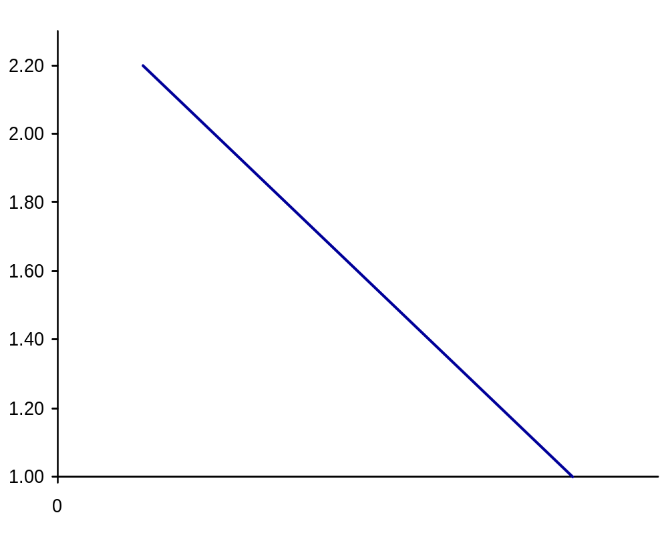
Determination of the rate of exchange
The lower the $ price of the GH¢ (the exchange rate), the cheaper it will be for them to obtain Ghanaian goods and assets,
and hence the more Ghana Cedis they are likely to demand
$ price of GH¢
D by USA
Q of ¢

Slide 72
Supply of Ghana Cedis (GH¢)
When Ghanaian importers wish to buy goods from the USA, or when Ghanaian residents wish to invest in the USA, they will supply Ghana Cedi on the foreign exchange market in order to obtain dollars
The higher the exchange rate, the more Ghana Cedis will be supplied.
The supply curve of Ghana Cedis, therefore, typically slopes upwards

Slide 73
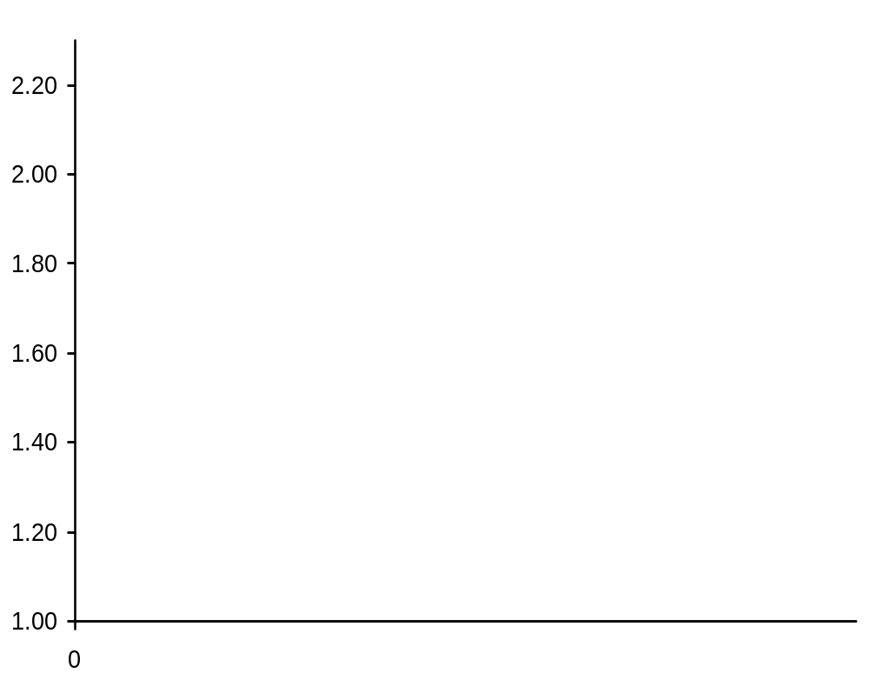
Determination of the rate of exchange
SS by Ghana
$ price of GH¢
Q of GH¢

Slide 74
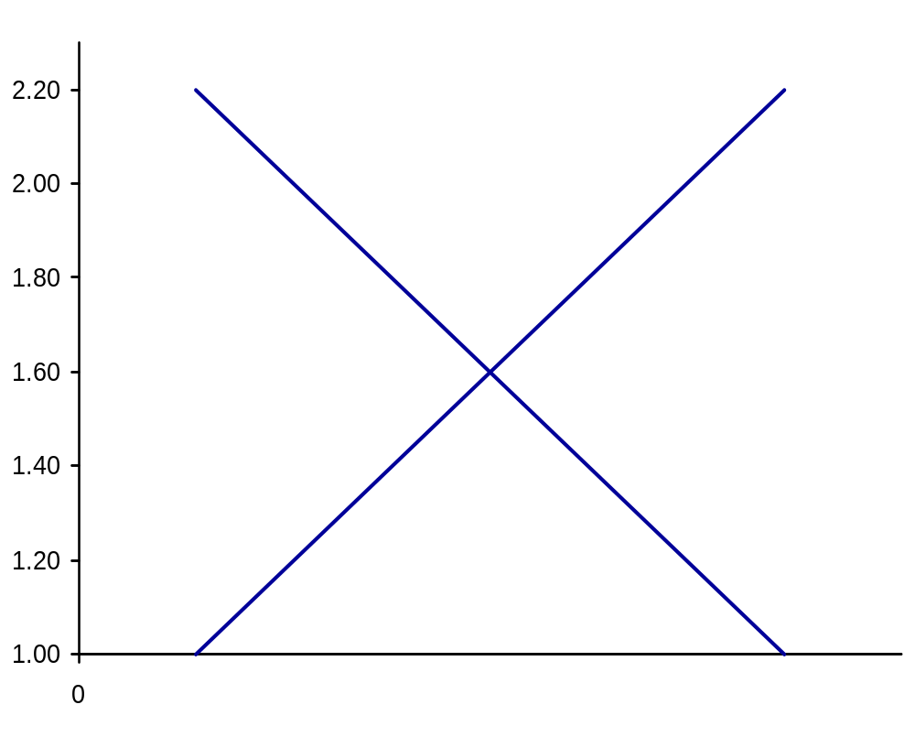
Determination of the rate of exchange
S by Ghana
Equilibrium
b
a
$ price of GH¢
Excess supply of Ghana Cedis leads to a depreciation.
D by USA
Q_{D}
Q₀
Q_{S}
Q of GH¢

Slide 75
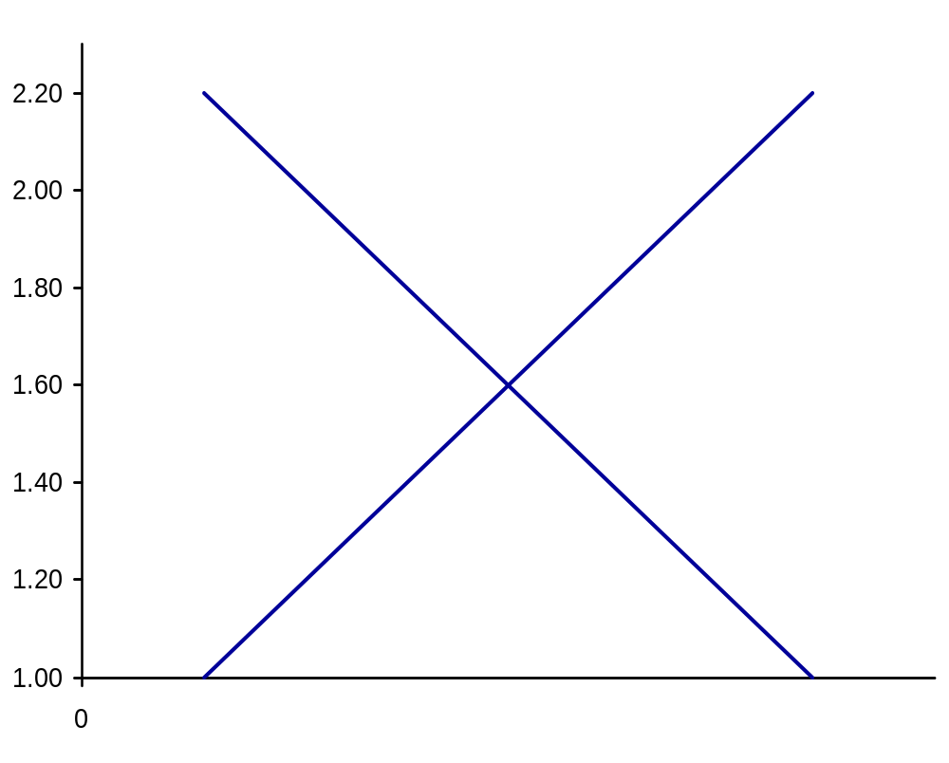
Determination of the rate of exchange
S by Ghana
$ price of GH¢
Shortage of Ghana Cedis leads to an appreciation.
d
c
D by USA
Q_{S}
Q_{D}
Q of GH¢

Slide 76
Shifts in the currency demand and supply curves
Any shift in the demand or supply curves will cause the exchange rate to change
A fall in the exchange rate is called a depreciation.
  That is, the currency falls in value relative to other currencies
A rise in the exchange rate is called an appreciation.
    That is, the currency increases in value relative to other currencies
Notes:
4

Slide 77
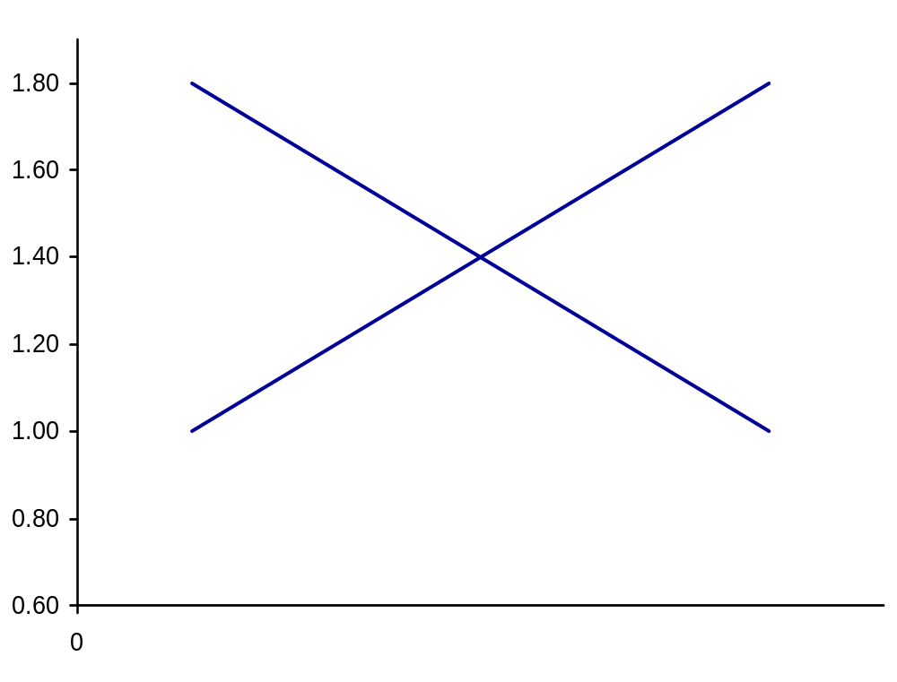
Floating exchange rates: movement to a new equilibrium
S₁
€ / £
D₁
Q of £

Slide 78
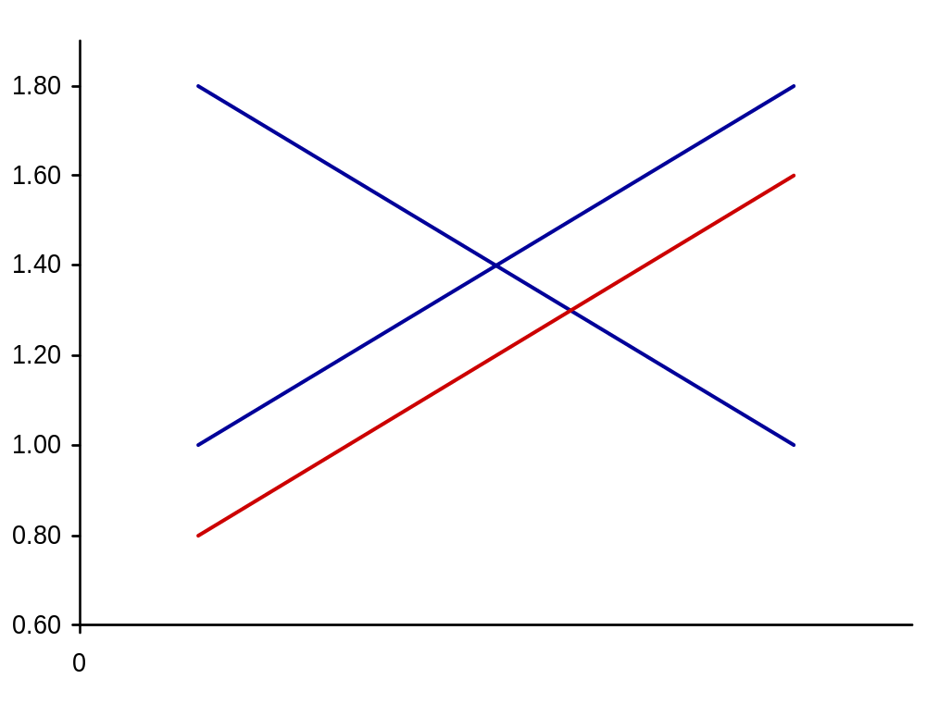
Floating exchange rates: movement to a new equilibrium
S₁
S₂
€ / £
D₁
Q of £

Slide 79
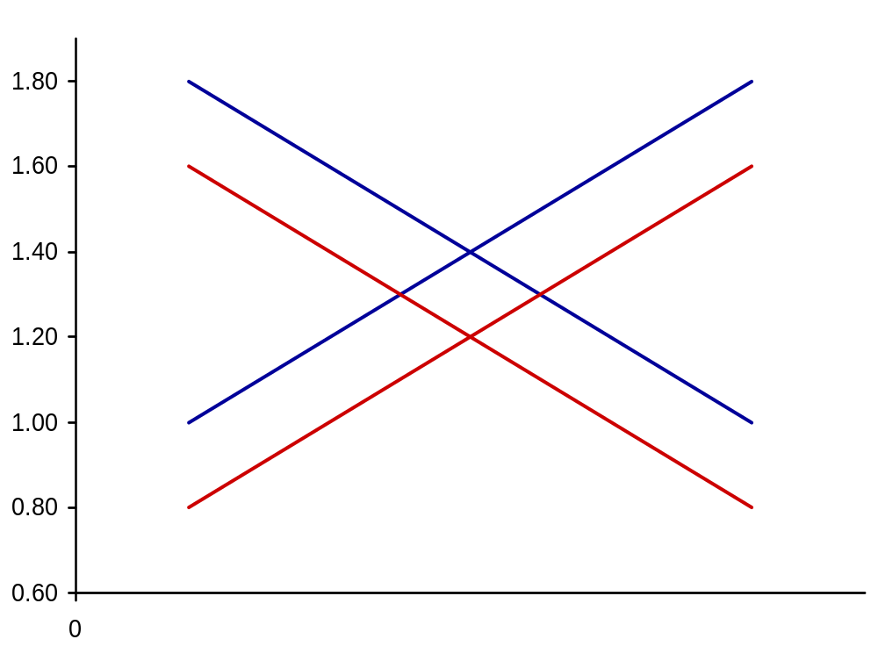
Floating exchange rates: movement to a new equilibrium
S₁
S₂
€ / £
D₁
D₂
Q of £

Slide 80

Only one of the following flows represents a demand for sterling. Which one?
Q
Imports of goods and services into the Ghana.
Ghanaian investment abroad.
Short-term financial outflows from the Ghana.
Profit earned from Ghanaian investment abroad.
Overseas aid by the Ghana government.

Slide 81
causes of shifts in currency demand and supply
The major possible causes of a depreciation:
  A fall in domestic interest rates.
  Higher inflation in the domestic economy than abroad
  A rise in domestic incomes relative to incomes abroad
  Relative investment prospects improving abroad.
  Speculation that the exchange rate will fall
Notes:
4

Slide 82
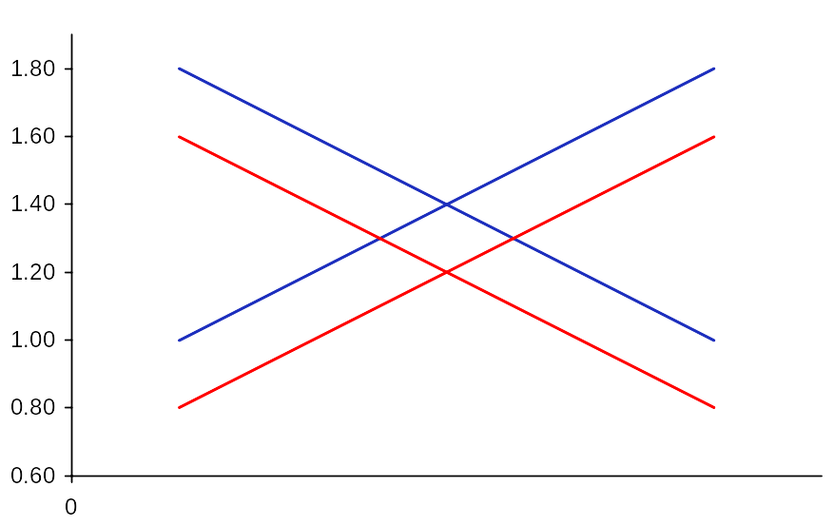
Factors that could lead to a depreciation of the GH¢
Higher inflation in Ghana than abroad
A rise in Ghana incomes
Fall in Ghana interest rates
Relative investment prospects improving abroad
Speculation that rate will fall
$ / GH¢
S₁
S₂
D₁
D₂
Q of GH¢

Slide 83
exchange rates and the balance of payments
In a free foreign exchange market, the balance of payments will automatically balance.
A floating exchange rate ensures that the demand for the Ghana Cedi always equals the supply.
It thus also ensures that the credits on the balance of payments are equal to the debits: that the balance of payments balances.
This does not mean that each part of the balance of payments account will separately balance, but simply that any current account deficit must be matched by a capital plus financial account surplus and vice versa.
Notes:
4

Slide 84
Managing the Exchange rates
Recall that one of the major macroeconomic goals is to achieve stability in the external value of the domestic currency by avoiding excessive depreciation & appreciation
Some government interventions include:
  reducing short-term fluctuations
    intervention using reserves, i.e. The BoG can sell gold and foreign currencies to buy the Ghana cedi
    borrowing from abroad or from IMF or Word Bank to buy the Ghana Cedi
    changes in interest rates i.e raising the interest rates will reduce the supply of the Cedi by encouraging saving and portfolio investment
Notes:
5

Slide 85
Alternative exchange rate regimes
There are a number of possible exchange rate regimes that lie somewhere between two extremes: totally fixed rate and a freely floating rate.
In the case of a totally fixed exchange rate the government takes whatever measures are necessary to maintain the exchange rate at some stated level.
As we discussed earlier, under the Freely floating exchange rate, the exchange rate is determined entirely by the forces of demand and supply in the foreign exchange market with no government intervention whatsoever.

Slide 86
Advantages of fixed exchange rates
Certainty for the business community
  With fixed exchange rates, international trade and investment become much less risky, since profits are not affected by fluctuations in the exchange rate.
Little or no speculation:
  Provided the rate is absolutely fixed – and people believe that it will remain so – there is no point in speculating.
Automatic correction of monetary errors.
  If the central bank allows the money supply to expand too fast, or the reduce too low, the interest rate will change affecting the exchange rate and the Bal of payment.
  This will force the central bank to intervene to support the exchange rate and hence correct the error.
Prevents governments from pursuing ‘irresponsible’ macroeconomic policies.
  deliberately and excessively expands aggregate demand – perhaps in an attempt to gain short-term popularity with the electorate –result in BOP deficit
  the resulting balance of payments deficit will force it to constrain demand again

Slide 87
Disadvantages of fixed exchange rates
According to new classical view:
  fixed exchange rates makes monetary policy ineffective
    E.g. If Ghana’s inflation rate is unacceptably high and the central bank tries to reduce inflation by attempting to reduce money supply and raise interest rates,
    the current and financial accounts will go into surplus.
    Money supply will thus increase until domestic inflation rises back to the original levels.
  fixed rates contradict the objective of having free markets
    In the new classical world where markets clear, and supply and demand are relatively elastic, why not treat the foreign exchange market like any other, and simply leave it to supply and demand

Slide 88
Disadvantages of fixed exchange rates
The Keynesian View
Keynesians argue that
Competitive deflations can be lead to recession worldwide
  When all countries competitively deflate their currencies in trying to achieve a balance of payments surplus and build up reserves, there may be world depression
There may be problems of excessive or insufficient international liquidity (i.e. the supply of currencies acceptable for world trade such as the dollars, euros, gold etc.)
speculation could be very severe if people came to believe that a fixed rate was about to break down.

Slide 89
Advantages of a free-floating exchange rate
Automatic correction
  The government simply lets the exchange rate move freely to the equilibrium. In this way, balance of payments disequilibria are automatically and instantaneously corrected without the need for specific government policies.
No problem of international liquidity and reserves
  Since there is no central bank intervention in the foreign exchange market, there is no need to hold reserves.
Insulation from external economic events
  Since the economy is not tied up to other countries, it is protected from high rates of inflation and other world economic fluctuations and shocks.
It gives governments a greater independence to pursue their chosen domestic policy
  Under a floating rate, the government can choose whatever level of domestic demand it considers appropriate, and simply leave exchange rate movements to take care of any balance of payments effect.

Slide 90
Disadvantages of a free-floating exchange rate
Speculations
  A completely free exchange rate movements are highly influenced by speculation. This can destabilize the activities of speculators and encourage the growth of speculative holdings of currency
Uncertainty for traders and investors
  The uncertainty caused by currency fluctuations can discourage international trade and investment.
Lack of discipline on the domestic economy
  A flexible exchange rate, by removing the balance of payments constraint on domestic policy, may encourage governments to pursue irresponsible domestic policies for short-term political gain.
  Also, unions and firms may well drive up wages and prices, without the fear of losing overseas markets

Slide 91

Which one of the following is likely to lead to persistent current account deficits under fixed exchange rates?
Q
A lower income elasticity of demand for the country’s exports than for its imports.
A lower rate of growth at home than abroad.
A higher rate of inflation abroad than in the domestic economy.
The long-term development of import substitutes at home.
A growth in the country’s monopoly power in the export market.

